Slide 1
Introduction to Information Systems and Programming
Design Patterns – I
Singleton and Observer

Slide 2
Software Design Pattern
Design patterns are formalized best practices that the programmer can use to solve common problems when designing an application or system. It is a description or template for how to solve a problem that can be used in many different situations.
Design patterns may be viewed as a structured approach to computer programming which is intermediate between the levels of a programming paradigm and a concrete algorithm.

Slide 3
What are design patterns?
How people have organized / designed their program in the past
Best software design solutions that others have encountered
Improve performance
Make it easier to modify the code
Can apply the same principle to your own software design
Solutions to common recurring problems in software design
One of the most valuable tools for developers / software designers

Slide 4
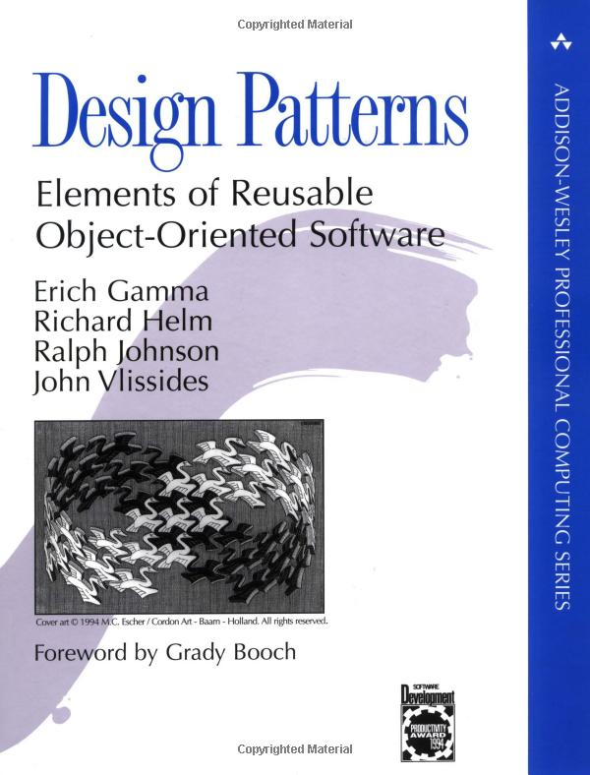
What are design patterns?
Comprehensive OO design pattern discussion:
Erich Gamma, Richard Helm, Ralph Johnson and John Vlissides (Gang of Four, GoF), “Design Patterns: Elements of Reusable Object-Oriented Software” Addison-Wesley 1994.
We will cover seven design patterns:
Singleton (C) Proxy (S)
Abstract Factory (C) State (B)
Observer (B) Flyweight (S)
Visitor (B)

Slide 5
Three types of Design Patterns
Creational patterns- create objects for you rather than having you instantiate objects directly. This gives your program more flexibility in deciding which objects need to be created for a given situation (case study)
Structural patterns help you to compose groups of objects into larger structures, such as complex user interfaces or accounting data
Behavioral patterns help you define the communication between objects in your system and how the flow is controlled in a complex program

Slide 6
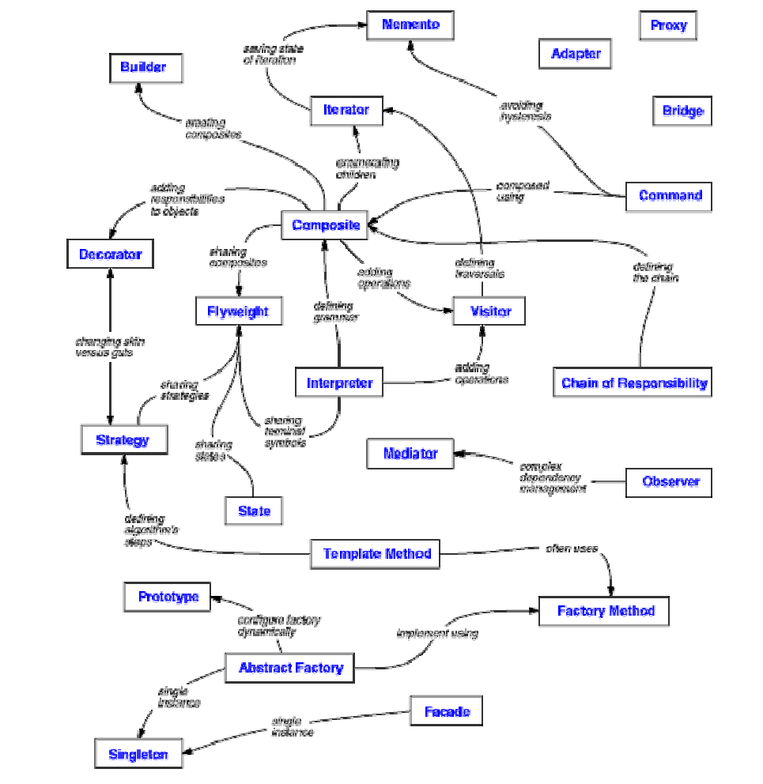
Collection of Design Patterns
Source: Gamma et al. Design Patterns

Slide 7
Three types of Design Patterns
C | Abstract Factory | S | Decorator | C | Prototype
S | Adapter | S | Facade | S | Proxy
S | Bridge | C | Factory Method | B | Observer
C | Builder | S | Flyweight | C | Singleton
B | Chain Of Responsibility | B | Interpreter | B | State
B | Command | B | Mediator | B | Template Method
S | Composite | B | Memento | B | Visitor

Slide 8
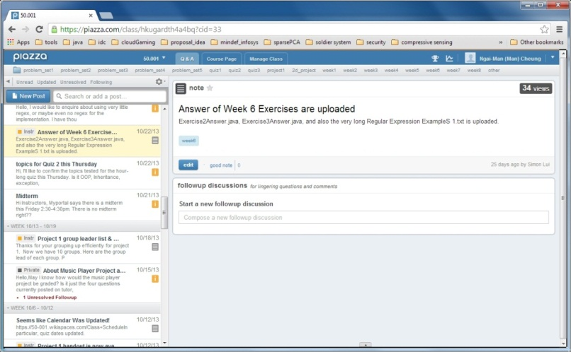
How to design the software?
Example 1: To ensure there is only one instance of an object, available to a number of other classes. E.g., A LogFile class for a pool of applications
Example 2: A message board: whenever a new message is posted to the topic, all the registered observers will be notified

Slide 9
Singleton
To ensure there is only one instance of an object, available to a number of other classes
E.g., Log file for a pool of applications
GoF: “Ensure a class has only one instance and provide a global point of access to it.”
A creational pattern: it is used to construct objects

Slide 10
Singleton Pattern
SingletonPatternDemo
+main(): void
asks
returns
SingleObject
-instance: SingleObject
-SingleObject()
+getInstance():SingleObject +showMessage():void

Slide 11
Singleton
public class Singleton {
private static Singleton instance= null;
private Singleton(){
}
public static Singleton getInstance(){
if (instance == null)
instance = new Singleton();
return instance;
}
}
-Private constructor
-Lazy instantiation: create the instance only when it is used

Slide 12
Singleton
Creational pattern, sometimes uses lazy initialization
Ensures a class has only one instance, and provides global access point to it
public class Singleton {
private Singleton () {} // private constructor
private static Singleton uniqueInstance =
new Singleton();
public static Singleton getInstance () {
return uniqueInstance;
// can be lazily initialized
}
}

Slide 13
Singleton (continued)
Better than global variables (controlled access, doesn't pollute namespaces)
More flexible than class operations (static methods): can be polymorphic and subclassed, permits easy design changes, etc.
Disadvantage: may result in coupled code, if used directly too much. Difficult to mock in unit tests

Slide 14
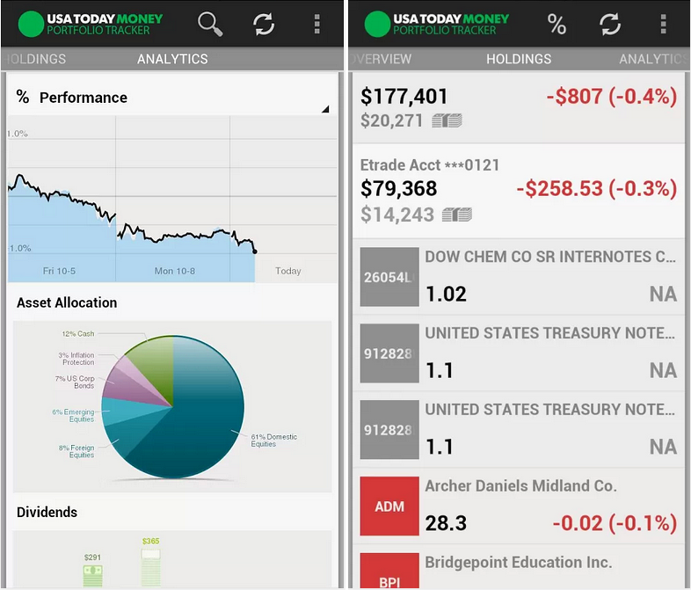
Observer
Useful when you are interested in the state of an object and want to get notified whenever there is any change
Subject (Publisher) maintains a list of its dependents (observers / subscribers)
Subject notifies them automatically of any state changes

Slide 15
Observer
GoF: “Define a one-to-many dependency between objects so that when one object changes state, all its dependents are notified and updated automatically.”
A behavioral pattern: form relationships between objects during execution at runtime

Slide 16
Observer Design Pattern
Subject
Observer
+register(Observer)
+unregister(Observer)
+notifyObservers()
+update()
update()
ConcreteObserver
ConcreteSubject
ConcreteObserver( Subject s):
s.register(this)
+observerList
notifyObservers():
for (Observer o: observerList)
o.update()

Slide 17
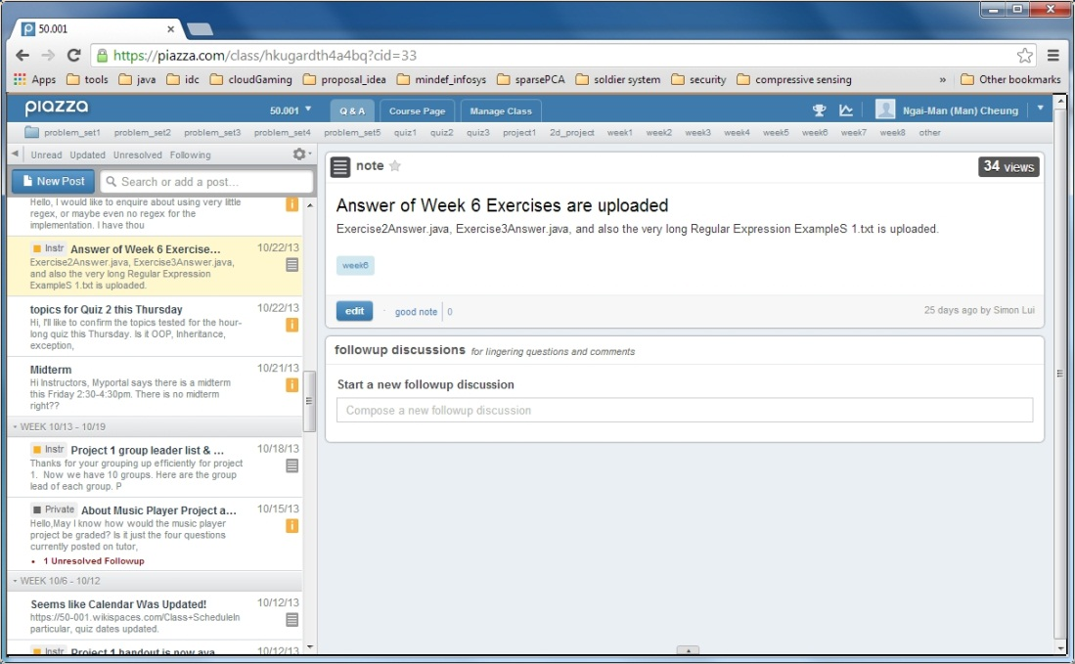
Example: Message board
Subject: a topic
Observers can register to this topic
Whenever a new message is posted to the topic, all the registered observers will be notified

Slide 18
Subject.java
public interface Subject {
void Attach(Observer o);
void Detach(Observer o);
void postMessage();
}
Attach: call to add a new observer
Detach: call to remover the observer
postMessage: inform all registered observers when state change occurs

Slide 19
Observer.java
public interface Observer {
void update(String msg);
}
update: call by Subject to inform Observer a change in state. Different classes of Observer can implement this different to respond to the change in state.

Slide 20
Topic.java
public class Topic implements Subject {
private String message; // the status
private ArrayList<Observer> observers;
public Topic (){
observers = new ArrayList<Observer>();
}
public void Attach(Observer o) {observers.add(o);}
public void Detach(Observer o) {observers.remove(o);}
public void postMessage(String msg) {
this.message = msg;
this.NotifyObservers();
}
private void NotifyObservers() {
for (Observer o: observers)
o.update(this.message);
}
// other features particular to Topic
}

Slide 21
Subscriber.java
public class Subscriber implements Observer {
private String message; // received message
private Subject subject;
public Subscriber(Subject subject){
this.subject = subject;
// register itself to the subject
this.subject.Attach(this);
}
@Override
public void update(String msg) {
// get update from Subject
this.message = msg;
// do something according to the update
...
}
}

Slide 22
Test.java
public class Test {
public static void main(String[] args) {
Topic topic50001 = new Topic();
Subscriber scott = new Subscriber(topic50001);
Subscriber roger = new Subscriber(topic50001);
//note Attach takes place within constructor
topic50001.postMessage("quiz tomorrow !!!");
Subscriber jit = new Subscriber(topic50001);
topic50001.postMessage(“HW due this Wed!!");
topic50001.Detach(Jit);
topic50001.postMessage(“Great! Jit has gone!");
}
}

Slide 23
Why Observer?
Reduce coupling. If an object needs to share it’s state with others, without knowing the identity of those objects are, the Observer is an ideal choice.
Useful in GUI programming, (among others). The concept of listeners is based on this pattern. The event listener is a good example. One registers an ActionListener to a GUI control, such a button, and react to action events using the actionPerformed method. In this case, the ActionListener is the Observer and the button is your Subject. As the button changes state, one can handle it with an appropriate method.

Slide 24
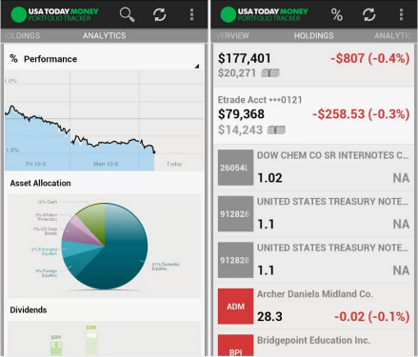
Cohort Activity
Using the Observer design pattern, develop a stock alert system that sends alerts to subscribers for any update of the stock prices
Develop StockGrabber class that keeps the list of subscribers for several stock prices, and notifies them for update
Develop StockObserver class that monitors changes in the stock prices
Develop a StockTest class to simulate the system

Slide 25
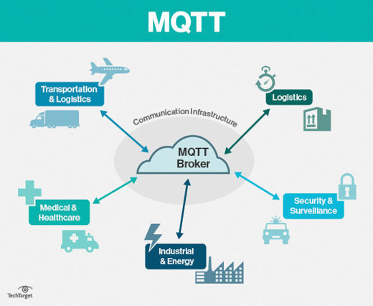
MQTT (MQ Telemetry Transport)
MQTT (Message Queuing Telemetry Transport) is a lightweight messaging protocol that provides resource-constrained network clients with a simple way to distribute telemetry information. The protocol, which uses a publish/subscribe communication pattern, is used for machine-to-machine (M2M) communication and plays an important role in the Internet of Things (IoT).

Slide 26
MQTT Methods
Connect: Waits for a connection to be established with the server.
Disconnect: Waits for the MQTT client to finish any work it must do, and for the TCP/IP session to disconnect.
Subscribe: Waits for completion of the Subscribe or UnSubscribe method.
UnSubscribe: Requests the server unsubscribe the client from one or more topics.
Publish: Returns immediately to the application thread after passing the request to the MQTT client.

